Slide 1
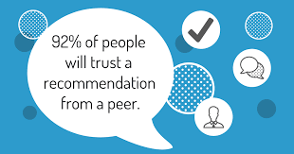

Cross Ref, Aug-20
The 5 steps to writing effective Case Studies

Slide 2

1. Preparation
Know in advance what outcome you are looking for
‘Interview’ your client first
Then, interview their customer
Importance of Third person

Slide 3
Who – is the audience? General public, teccies, marketing managers, CEOs…?
What – problems do they usually face and what are the benefits of your solution (both quantitative and qualitative)?
Where – do they buy your product/service?
Why – do they buy from you versus a competitor?
When – do they make a purchasing decision?

Slide 4
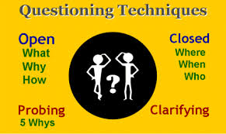
2. Interviewing
Ask Open questions
How did product/service make you feel? [you’re looking for emotions here – relieved, grateful….or negative ones if they had a bad experience with a competitor’s offering – angry, frustrated]
Could you describe the product/service in 3 words? [forces the interviewee to be creative – something you can then expand upon in further questioning]
What challenges was your business facing? [nearly everybody likes to talk about their own business….careful though to keep them on track and not run out of time!]

Slide 5

3. Write-up
You’ve got all your background and raw material – - now all you need to do is to put it all together
Catchy title – words such as ‘How’, ‘Why’, have far more impact, especially when looking to recycle the Case Study on twitter, linkedin…etc, where the title has to ‘sell it’; e.g. ‘How Company xx doubled their revenues in 6 months’
Headings/Sub-headings – help to break up the text and ‘guide’ the reader through
Testimonial quotes – make sure these can stand on their own two feet
Colloquialisms – leave in when referring to the interviewee (it’s authentic), but keep the narrator’s voice as neutral and grammatically correct

Slide 6

4. Approval
This stage – getting hold of people to approve the write-up – can often be the most time-consuming, so be patient!
I prefer to email through the plain text, ideally without any formatting, on the face of the email (as opposed to an attachment – you’d be surprised how many can get stuck in Spam/Junk or trigger virus alerts, especially in bigger organisations).
Make it easy to ‘edit‘ – if it’s unformatted, the interviewee can add changes directly to the face of the text, in bold or a different colour
Email confirmation is preferable – this provides you with an audit trail

Slide 7
4. Approval
Don’t be afraid to ‘polish’ quotes where necessary, by repeating what the interviewee has said to you with a few ‘tweaks’ of your own:
Would it be fair to say….?
Could we phrase it like this…..?
So the way I understand it is…..?

Slide 8

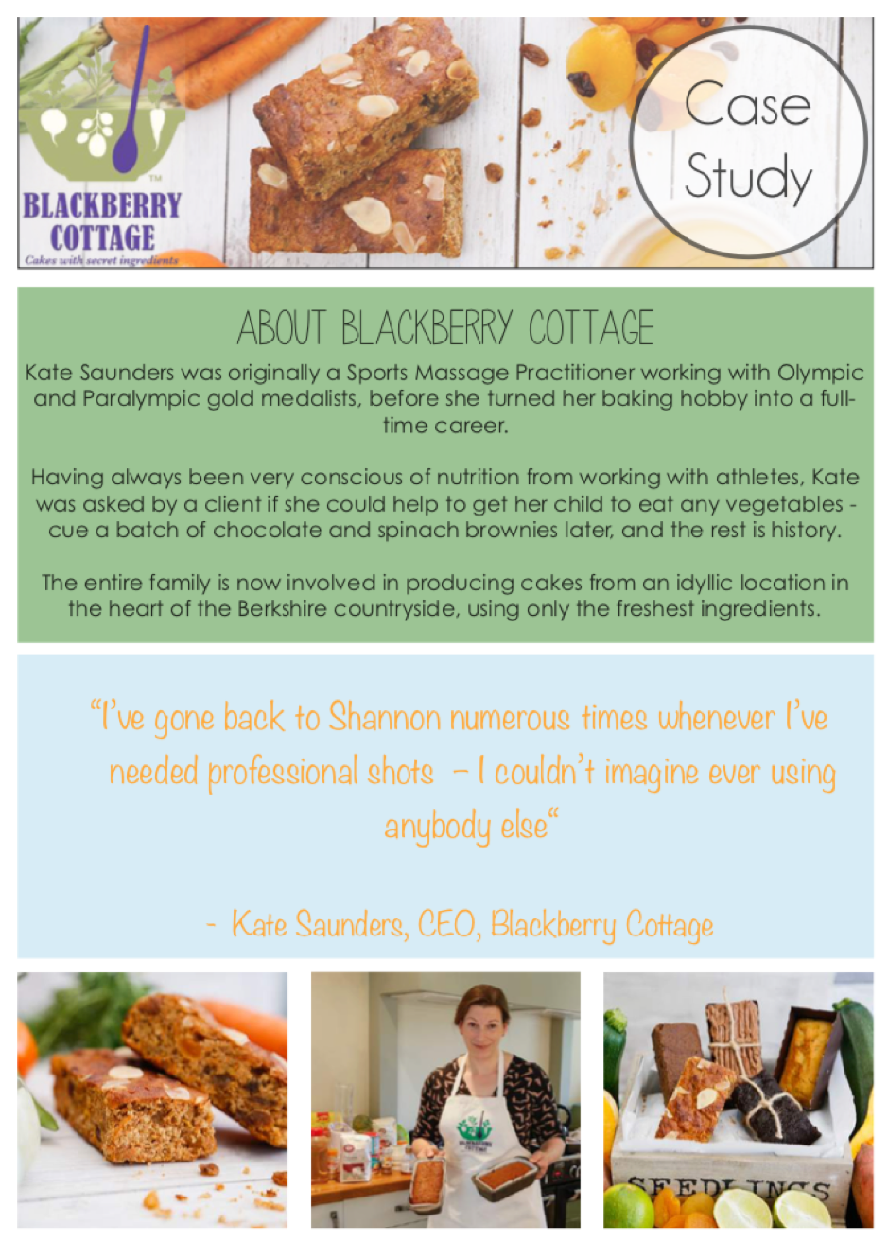
5. Design

Slide 9

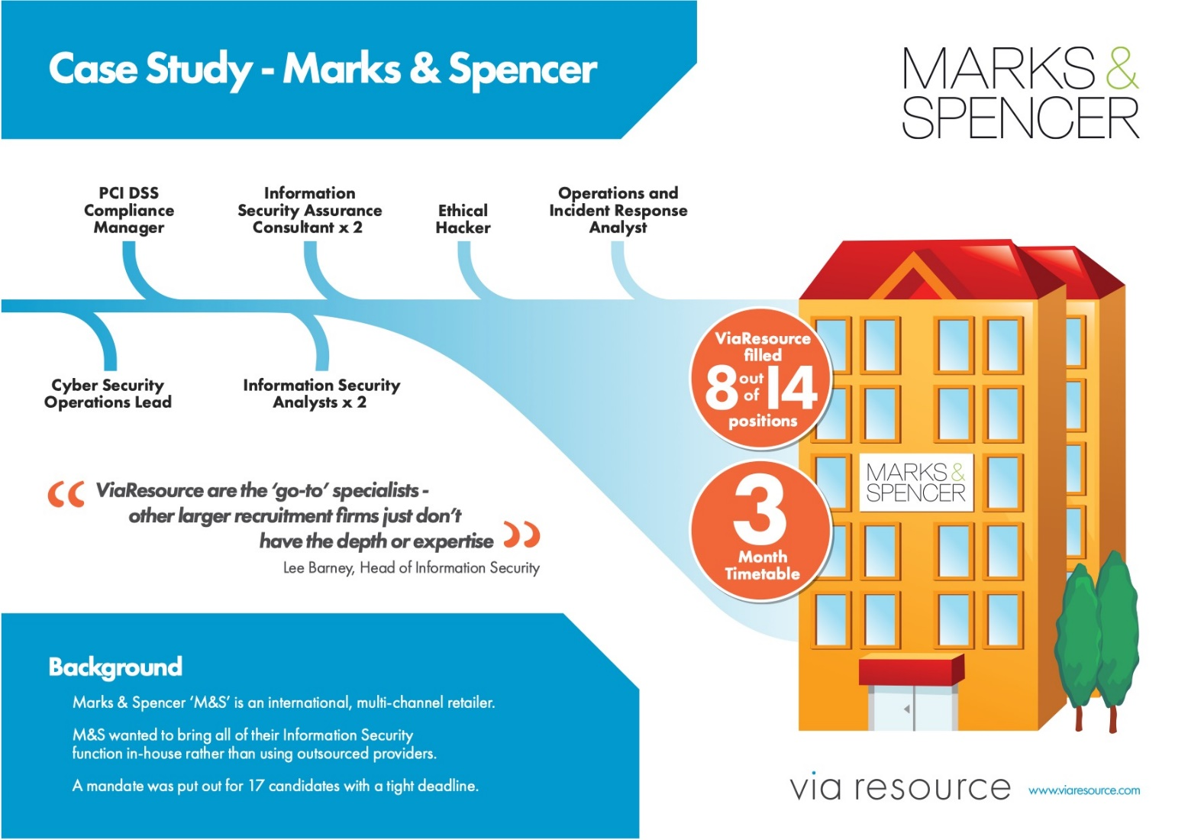
5. Design

Slide 10
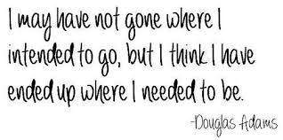
Q&A

